Slide 1
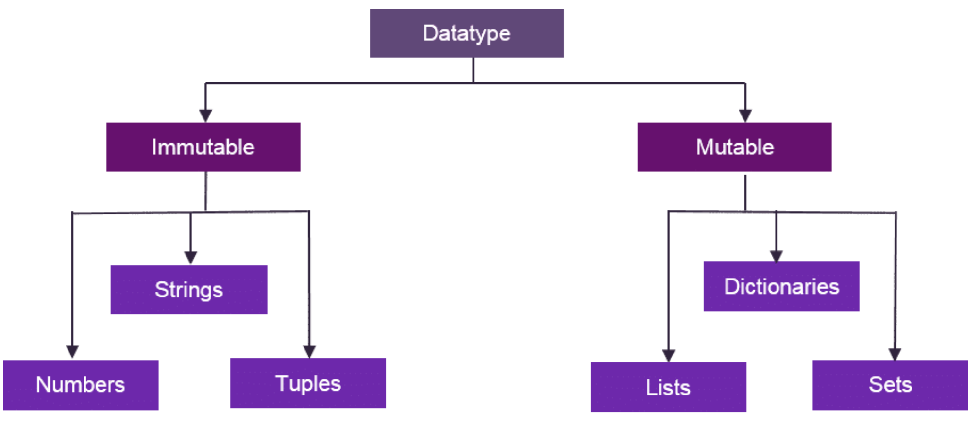
Python 3 Data Types
https://intellipaat.com/blog/tutorial/python-tutorial/

Slide 2
What is important for us?
Boolean
True, False
3 < 4
Numbers
int, float, complex
23, 45.6, 3 + 4j
Strings
‘hello’, ”hello”, ‘’’ hello ‘’’
‘\n’, “hello\tworld”
Lists
[], [‘hello’, 1, 2]
[‘Wednesday’, [11,12]]
Tuples
(“Jane Doe”, 12345678)
Sets
{‘Monday’, ‘Tuesday’}
Dictionaries
{“Jane Doe”:12345678, “John Doe”: 90123456}

Slide 3
‘Strings’
Strings
Any text data, names, descriptions, reviews, tweets, emails, file contents, etc.
Sequence of characters
‘hello’, ”hello”, ‘’’ hello ‘’’, input function
‘\n’, “hello\tworld” # special characters as single
Order is important and indexed starting from 0(zero)
Immutable
name=‘Zeynep’
name=‘Zeynep Orhan’ #not the same with previous name
name[0]=‘U’ # Errror
Useful functions
len
Concatenation +

Slide 4
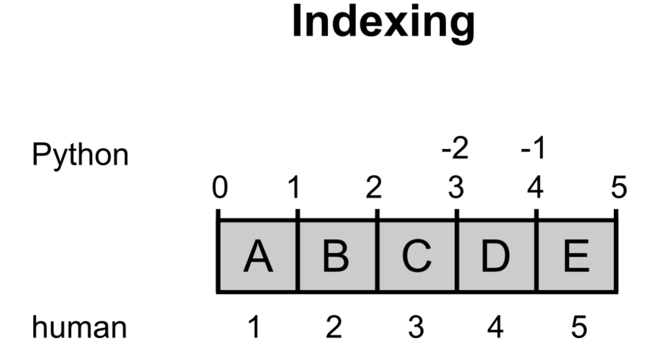
https://krother.gitbooks.io/python-3-basics-tutorial/content/en/lists/

Slide 5
‘Strings’
>>> a='hello'
>>> b='world'
>>> c='hello\tPython\nis fun'
>>> d='''Barack Obama'''
>>> type(a)
<class 'str'>
>>> type(b)
<class 'str'>
>>> type(c)
<class 'str'>
>>> type(d)
<class 'str’>
>>> id(a)
4300763696
>>> a='Hello'
>>> id(a)
4300738736
>>> len(a)
5
>>> len(c)
19
>>> print(a+d)
helloBarack Obama
>>> name=input('Name:')
Name:Zeynep
>>> print(a+' '+name)
hello Zeynep

Slide 6
[Lists]
Lists
Container
Collection not a single value
Names, email addresses, shopping list, etc.
Can have any data type even lists(nested)
Enclosed in [ ]
Elements are comma separated
[], [’bread’, ’milk’]
Order is important and indexed starting from 0(zero)
Mutable
shopping_list= [’bread’, ’milk’]
shopping_list[0]=‘butter’
Useful functions
len
Concatenation +
Useful methods
list_name.method_name
append: add to the end
remove: remove first match
pop: remove ith index

Slide 7
[Lists]
>>> shopping_list=['bread','milk']
>>> shopping_list
['bread', 'milk']
>>> type(shopping_list)
<class 'list'>
>>> shopping_list[0]='butter'
>>> shopping_list
['butter', 'milk']
>>> len(shopping_list)
2
>>> new_list=shopping_list+[‘cheese']
>>> new_list
['butter', 'milk', ‘cheese']
>>> shopping_list
['butter', 'milk']
>>> shopping_list.append('egg')
>>> shopping_list
['butter', 'milk', 'egg']
>>> shopping_list.append('egg')
>>> shopping_list
['butter', 'milk', 'egg', 'egg']
>>> shopping_list.remove('egg')
>>> shopping_list
['butter', 'milk', 'egg']
>>> shopping_list.pop(1)
'milk'
>>> shopping_list
['butter', 'egg']

Slide 8
(Tuples)
Tuples
Sequence and list like
Values are not changing like your name and SSN
Enclosed in ( )
Elements are comma separated
(’Jane Doe’, 12345678)
Order is important and indexed starting from 0(zero)
Immutable
Useful functions
len
Concatenation +

Slide 9
(Tuples)
>>> ssn1=('Jane Doe', 12345678)
>>> ssn1[0]
'Jane Doe'
>>> ssn1[1]
12345678
>>> ssn1[1]=90909090
Traceback (most recent call last):
File "<pyshell#74>", line 1, in <module>
ssn1[1]=90909090
TypeError: 'tuple' object does not support item assignment
>>> ssn1
('Jane Doe', 12345678)
>>> type(ssn1)
<class 'tuple'>
>>> len(ssn1)
2
>>> ssn1+('a',1)
('Jane Doe', 12345678, 'a', 1)
>>> not_ssn=ssn1+('a',1)
>>> not_ssn
('Jane Doe', 12345678, 'a', 1)
>>> type(not_ssn)
<class 'tuple'>
>>> len(not_ssn)
4

Slide 10
{Sets}
Sets
Collection not a single value but distinct values
Unordered, no indexing
Days of the week, names of the months, etc.
Enclosed in { } or create by using set()
Elements are comma separated
set([’bread’, ’milk’]), {'bread', 'milk'}
Mutable
shopping_list= {’bread’, ’milk’}
shopping_list.add(‘butter’)
Useful functions
len
Useful methods
set_name.method_name
add: add to the end
remove: remove first match
pop: remove random
intersection
union
difference

Slide 11
{Sets}
>>> week_days={'Mon','Tue’}
>>> week_days.add('Thu')
>>> week_days
{‘Tue', 'Mon', ‘Thu'}
>>> week_days.add('Thu')
>>> week_days
{‘Tue', 'Mon', ‘Thu'}
>>> len(week_days)
3
>>> week_days.remove('Tue')
>>> week_days
{'Thu', 'Mon'}
>>> week_days.pop()
'Thu'
>>> week_days
{'Mon’}
>>> week_days.intersection({'Mon'})
{'Mon'}
>>> week_days.union({'Fri'})
{'Mon', 'Fri'}
>>> week_days.difference({'Mon','Thu'})
set()
>>> week_days
{'Mon'}
>>> week_days.difference({'Thu'})
{'Mon'}

Slide 12
{‘Dict’: ‘ionaries’}
Dictionaries
Collection not a single value
Key-value pairs and mapping
Id number and names, email addresses and names, states and capitals, etc.
Enclosed in {key:value}
Elements are comma separated
{}, capitals={’NY’: ’Albany’}
No order or index
Access by key
Mutable
Add capitals[ ‘CA’]= ’Sac’
Update capitals[ ‘CA’]= ’Sacramento’
del capitals[‘CA’]
Useful functions
len

Slide 13
{‘Dict’: ‘ionaries’}
>>> capitals={'NY': 'Albany'}
>>> len(capitals)
1
>>> capitals
{'NY': 'Albany'}
>>> type(capitals)
<class 'dict'>
>>> capitals['CA']='Sac'
>>> capitals
{'NY': 'Albany', 'CA': 'Sac'}
>>> capital['CA']='Sacramento'
Traceback (most recent call last):
File "<pyshell#129>", line 1, in <module>
capital['CA']='Sacramento'
NameError: name 'capital' is not defined
>>> capitals['CA']='Sacramento'
>>> capitals
{'NY': 'Albany', 'CA': 'Sacramento'}
>>> del capitals['CA']
>>> capitals
{'NY': 'Albany'}
>>> del capitals['CA']
Traceback (most recent call last):
File "<pyshell#135>", line 1, in <module>
del capitals['CA']
KeyError: 'CA'

Slide 14
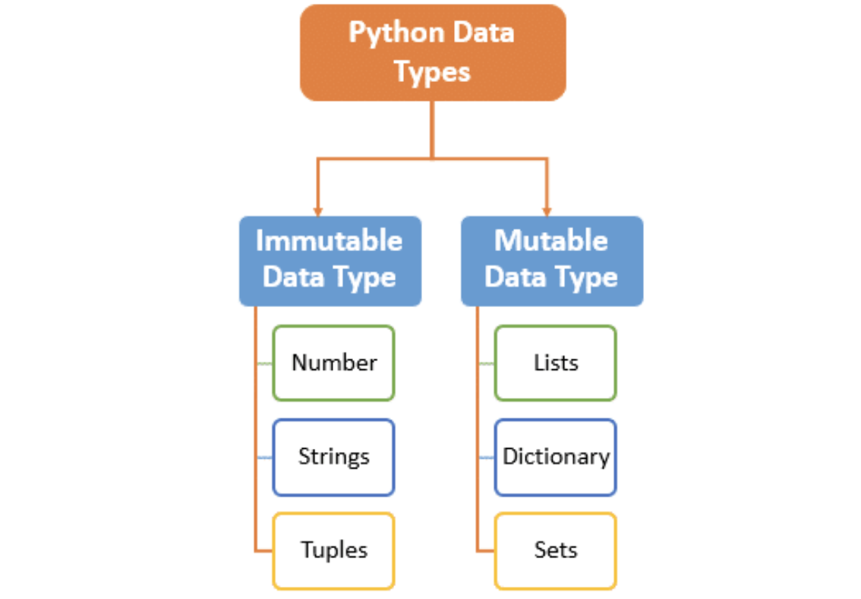
Summary
https://intellipaat.com/mediaFiles/2019/02/pyhon3.png

Slide 15
Matching Game
489
complex
list
dictionary
int
{‘a’,’b’}
3.45
{‘Mary’:’MIT’}
float
set
2j
[a, [b,c]]
(‘July 4’, ‘Independence Day’)
boolean
5*6 != 30
tuple
16+24
(‘0’, ‘A’, ‘B’, ‘AB’)

Slide 16

Questions➔
Discussion Forum

Slide 17


